Slide 1
MAHARISHI INTERNATIONAL UNIVERSITY
1971-1995
MAHARISHI UNIVERSITY
of
MANAGEMENT
Engaging the Managing
Intelligence of Nature

Slide 2
Lab 2:
Patterns:Iterator and Visitor

Slide 3
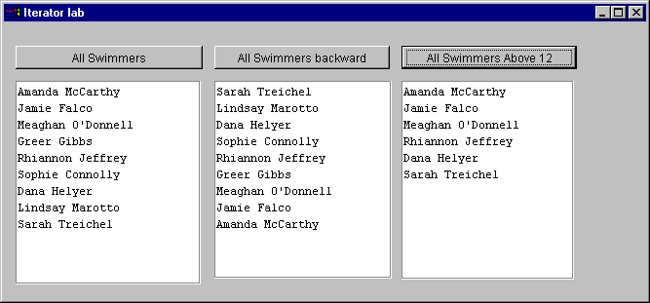
Iterator: Lab

Slide 4
Iterator: Lab without iterator
void JButtonAllSwimmers_actionPerformed(java.awt.event.ActionEvent event)
{ Vector vectorlist = slist.getVector();
for (int x=0; x<vectorlist.size(); x++){
Swimmer swimmer= (Swimmer)vectorlist.elementAt(x);
JTextArea1.append(swimmer.getFname()+" "+swimmer.getLname()+ "\n");
}
}
void JButtonAllBackward_actionPerformed(java.awt.event.ActionEvent event)
{ Vector vectorlist = slist.getVector();
for (int x=vectorlist.size()-1; x>-1; x--){
Swimmer swimmer= (Swimmer)vectorlist.elementAt(x);
JTextArea2.append(swimmer.getFname()+" "+swimmer.getLname()+ "\n");
}
}
void JButtonAllAbove12_actionPerformed(java.awt.event.ActionEvent event)
{ Vector vectorlist = slist.getVector();
for (int x=0; x<vectorlist.size(); x++){
Swimmer swimmer= (Swimmer)vectorlist.elementAt(x);
if (swimmer.getAge()>=12)
JTextArea3.append(swimmer.getFname()+" "+swimmer.getLname()+ "\n");
}
}

Slide 5
Iterator: Lab
Use Java’s build in iterator
Write your own reverse iterator
Write your own internal iterator

Slide 6
Visitor

Slide 7
Visitor : Lab
public class Application {
public static void main(String args[]) {
LList list = new LList();
Integer i = new Integer(2);
list.add(i);
Character c = new Character('4');
list.add(c);
Float f = new Float(9.6);
list.add(f);
Integer i1 = new Integer(3);
list.add(i1);
Character c1 = new Character('7');
list.add(c1);
Float f1 = new Float(2.9);
list.add(f1);
float sum= list.computeSum();
System.out.println("the sum is: "+sum);
}
}
public class LList {
private Vector list = new Vector();
public void add(Object element){
list.addElement(element);
}
public float computeSum(){
?????
}
}

Slide 8
Visitor : Lab Solution 1
Instanceof and Type Casts
public float computeSum(){
float tot=0;
for (int x=0; x<list.size(); x++){
Object element=list.elementAt(x);
if (element instanceof Integer)
tot+=((Integer)element).floatValue();
else if (element instanceof Character)
tot+=Character.getNumericValue(((Character)element).charValue());
else tot+=((Float)element).floatValue();
}
return tot;
}

Slide 9
Visitor : Lab Solution 2
Dedicated Methods
public class LFloat implements ListElement{
Float value;
public LFloat(float floatval){
value=new Float(floatval);
}
public float getFlValue(){
return value.floatValue();
}
}
public class LList {
….
public float computeSum(){
float tot=0;
for (int x=0; x<list.size(); x++){
ListElement element=
(ListElement)list.elementAt(x);
tot+=element.getFlValue();
}
return tot;
}
}
public interface ListElement{
public float getFlValue();
}
public class LInteger implements ListElement{
Integer value;
public LInteger(int intval){
value= new Integer(intval);
}
public float getFlValue(){
return value.floatValue();
}
}
public class LCharacter implements ListElement{
Character value;
public LCharacter(char charval){
value= new Character(charval);
}
public float getFlValue(){
return Character.getNumericValue(
value.charValue());
}
}

Slide 10
Visitor : Lab Solution 3
Use the visitor pattern
Add a visitor that multiplies only the integer and float elements in the list. (Character elements are not multiplied).

Slide 11
© 2000 Maharishi University of Management, Fairfield, Iowa, USA
This tape may not be copied, duplicated, or distributed without written consent from Maharishi University of Management, Fairfield, Iowa, USA.

Slide 12
® Science of Creative Intelligence is a service mark registered in the United States Patent and Trademark Office, licensed to Maharishi Vedic Education Development Corporation, and is used under sublicense.

